Slide 1
Portfolio Website
A personal portfolio showcasing skills, projects, and contact details

Slide 2
Key Features
Home Section: Introduction with profile picture
About Section: Educational background and experience
Projects Section: Showcasing completed projects
Skills Section: Listing technical and soft skills
Contact Section: Contact form with email validation

Slide 3
Technologies Used
HTML5: Structuring the web pages
CSS3: Styling and responsiveness
JavaScript: Form validation and navigation highlight
Google Fonts: Typography enhancement

Slide 4
JavaScript Features
Contact form validation
Navigation highlighting based on scroll position
Smooth scrolling between sections

Slide 5
Responsive Design
Uses flexbox and grid for layout adjustments
Adapts to various screen sizes (mobile-friendly)
Sticky navigation bar for better UX

Slide 6
Contact Form Functionality
Prevents submission if fields are empty
Displays an alert message upon successful submission
Resets form fields after submission

Slide 7
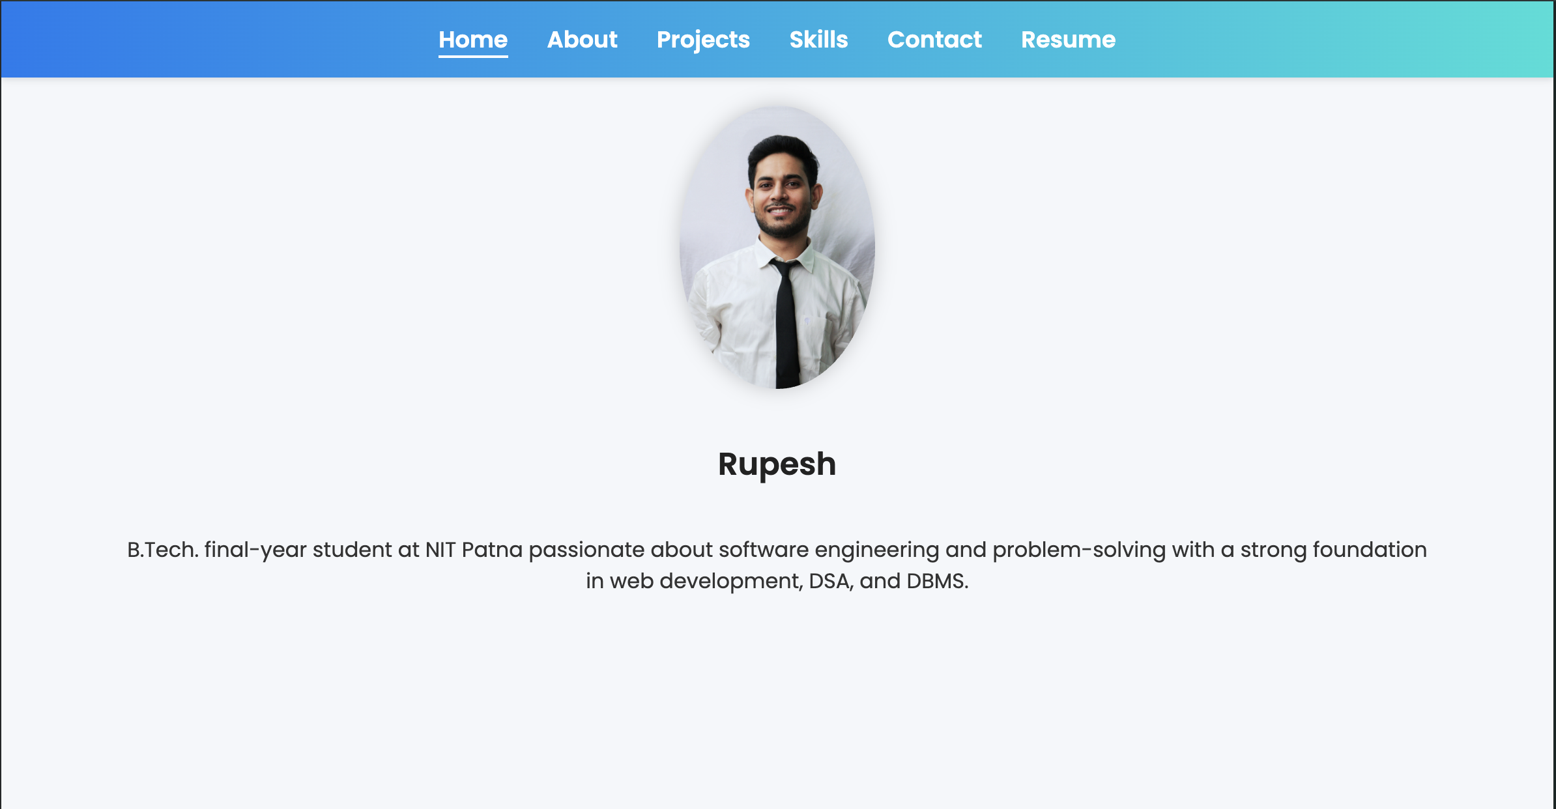
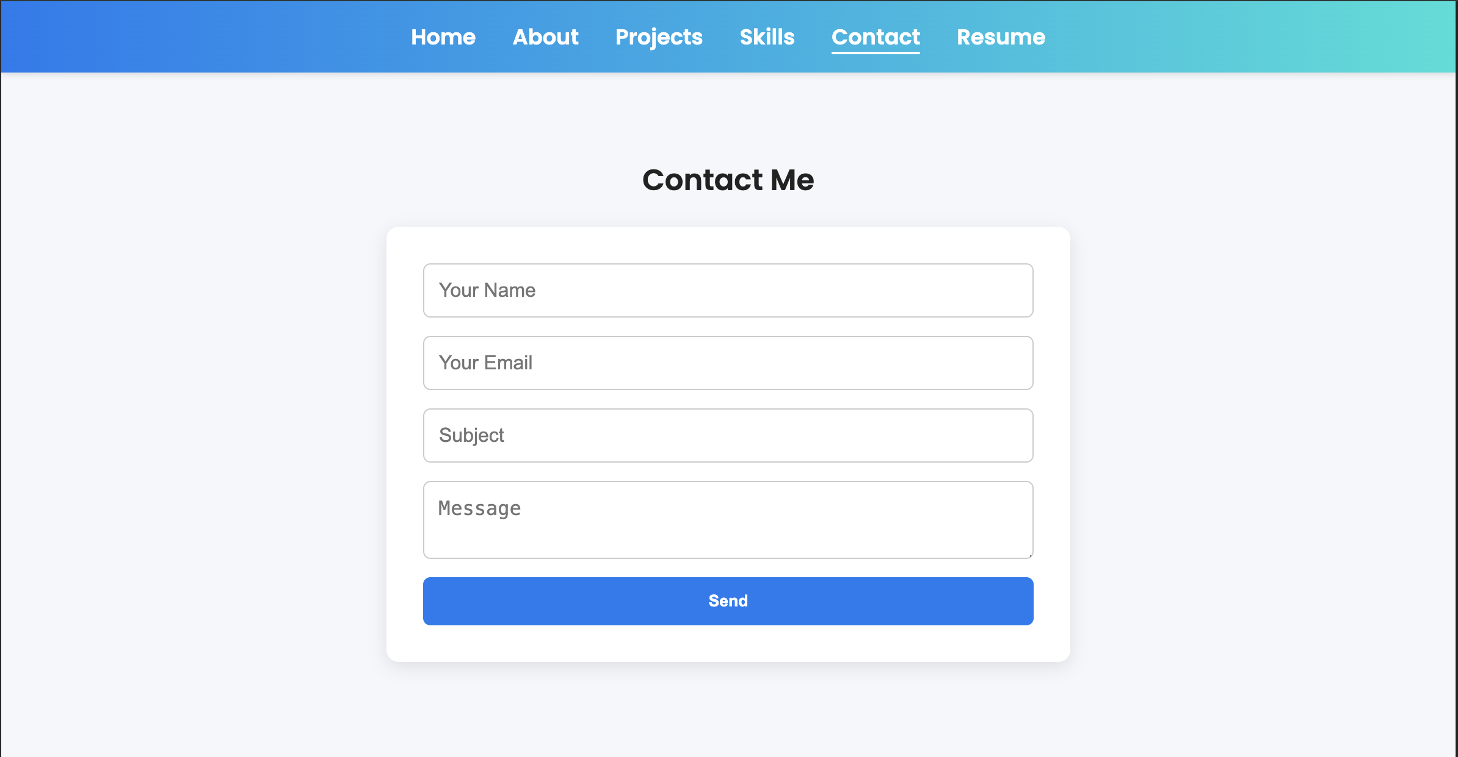
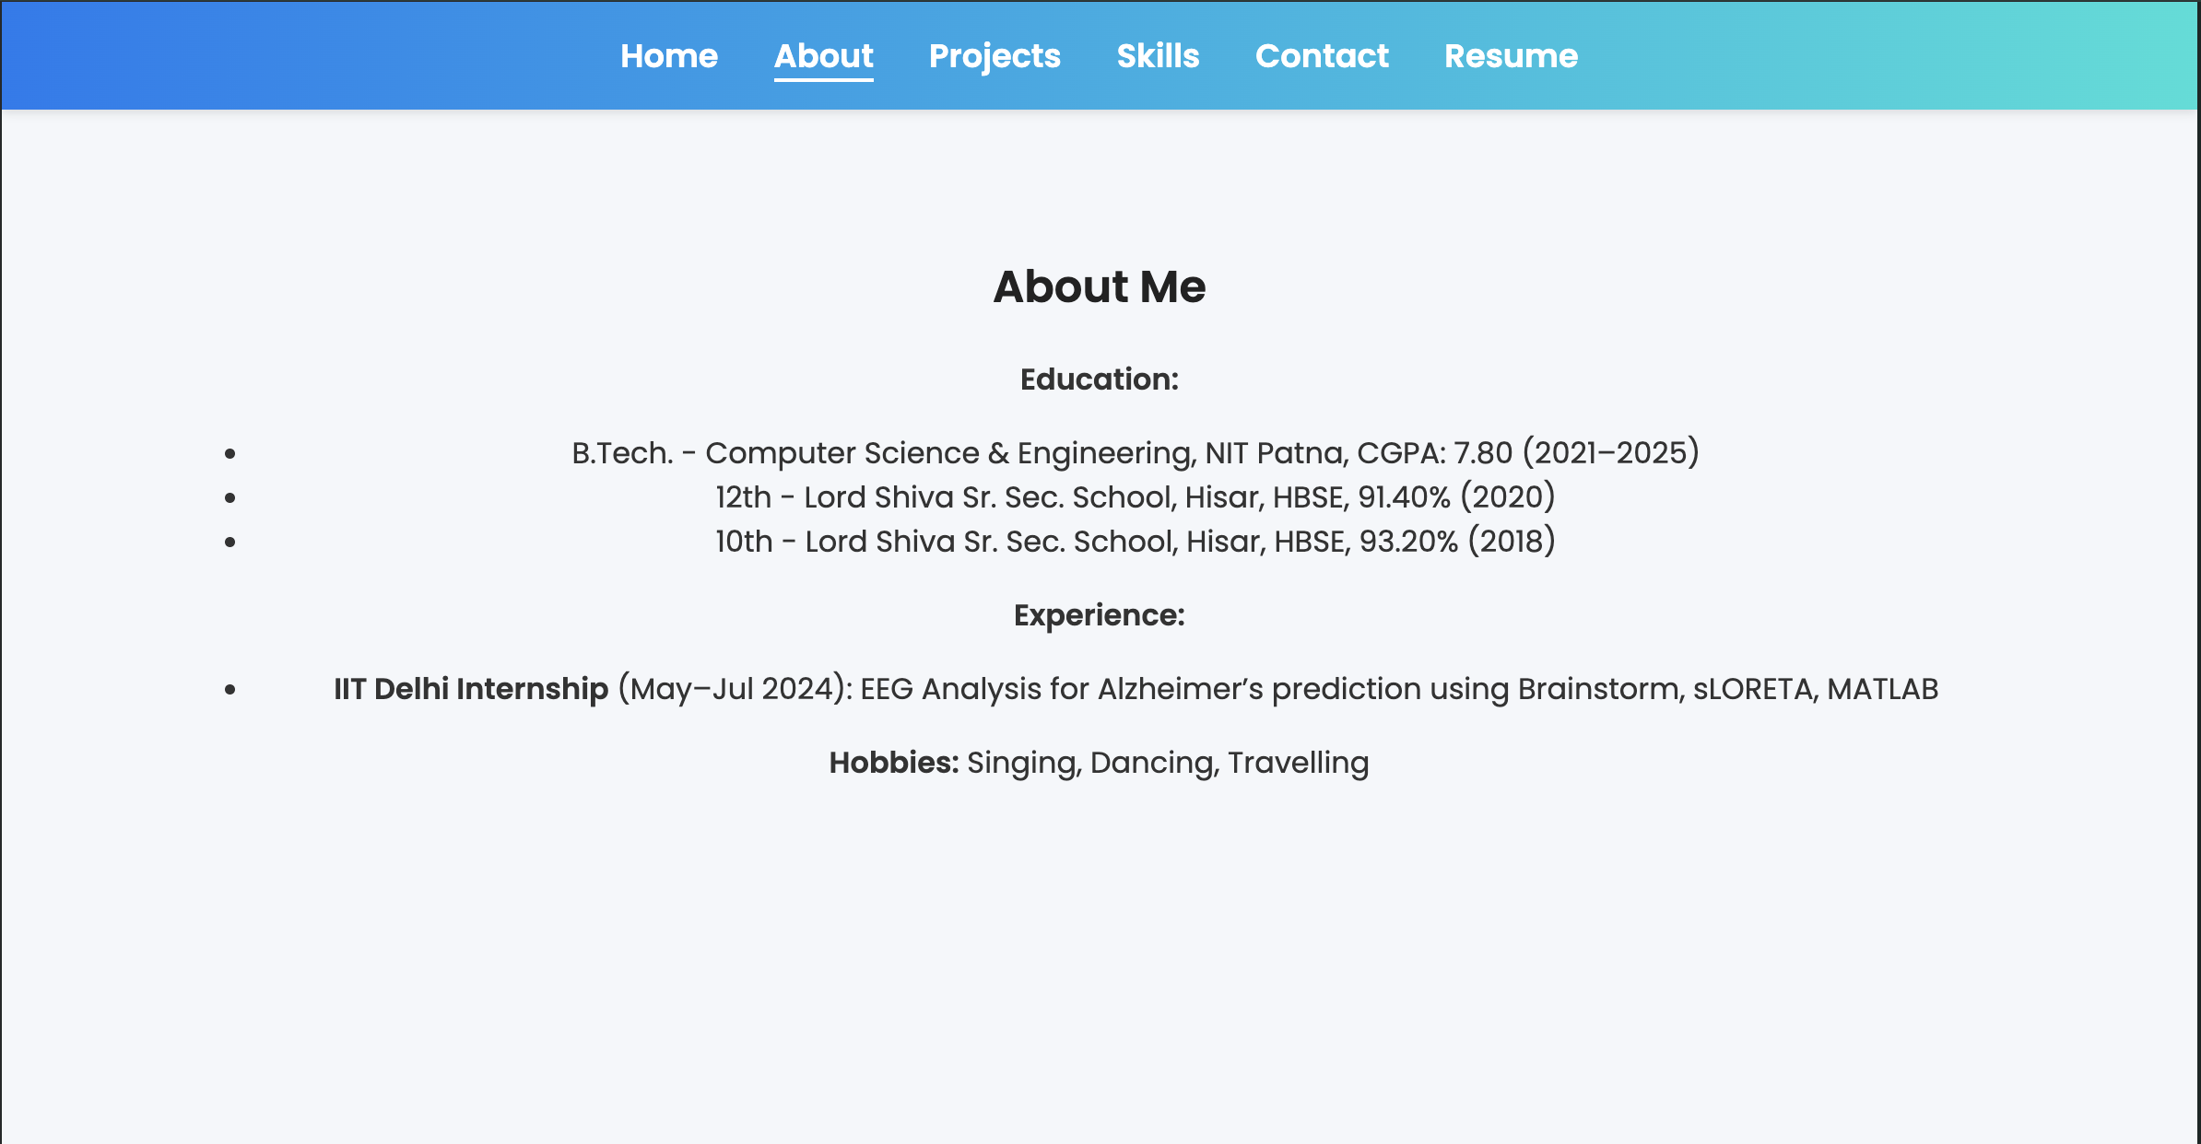
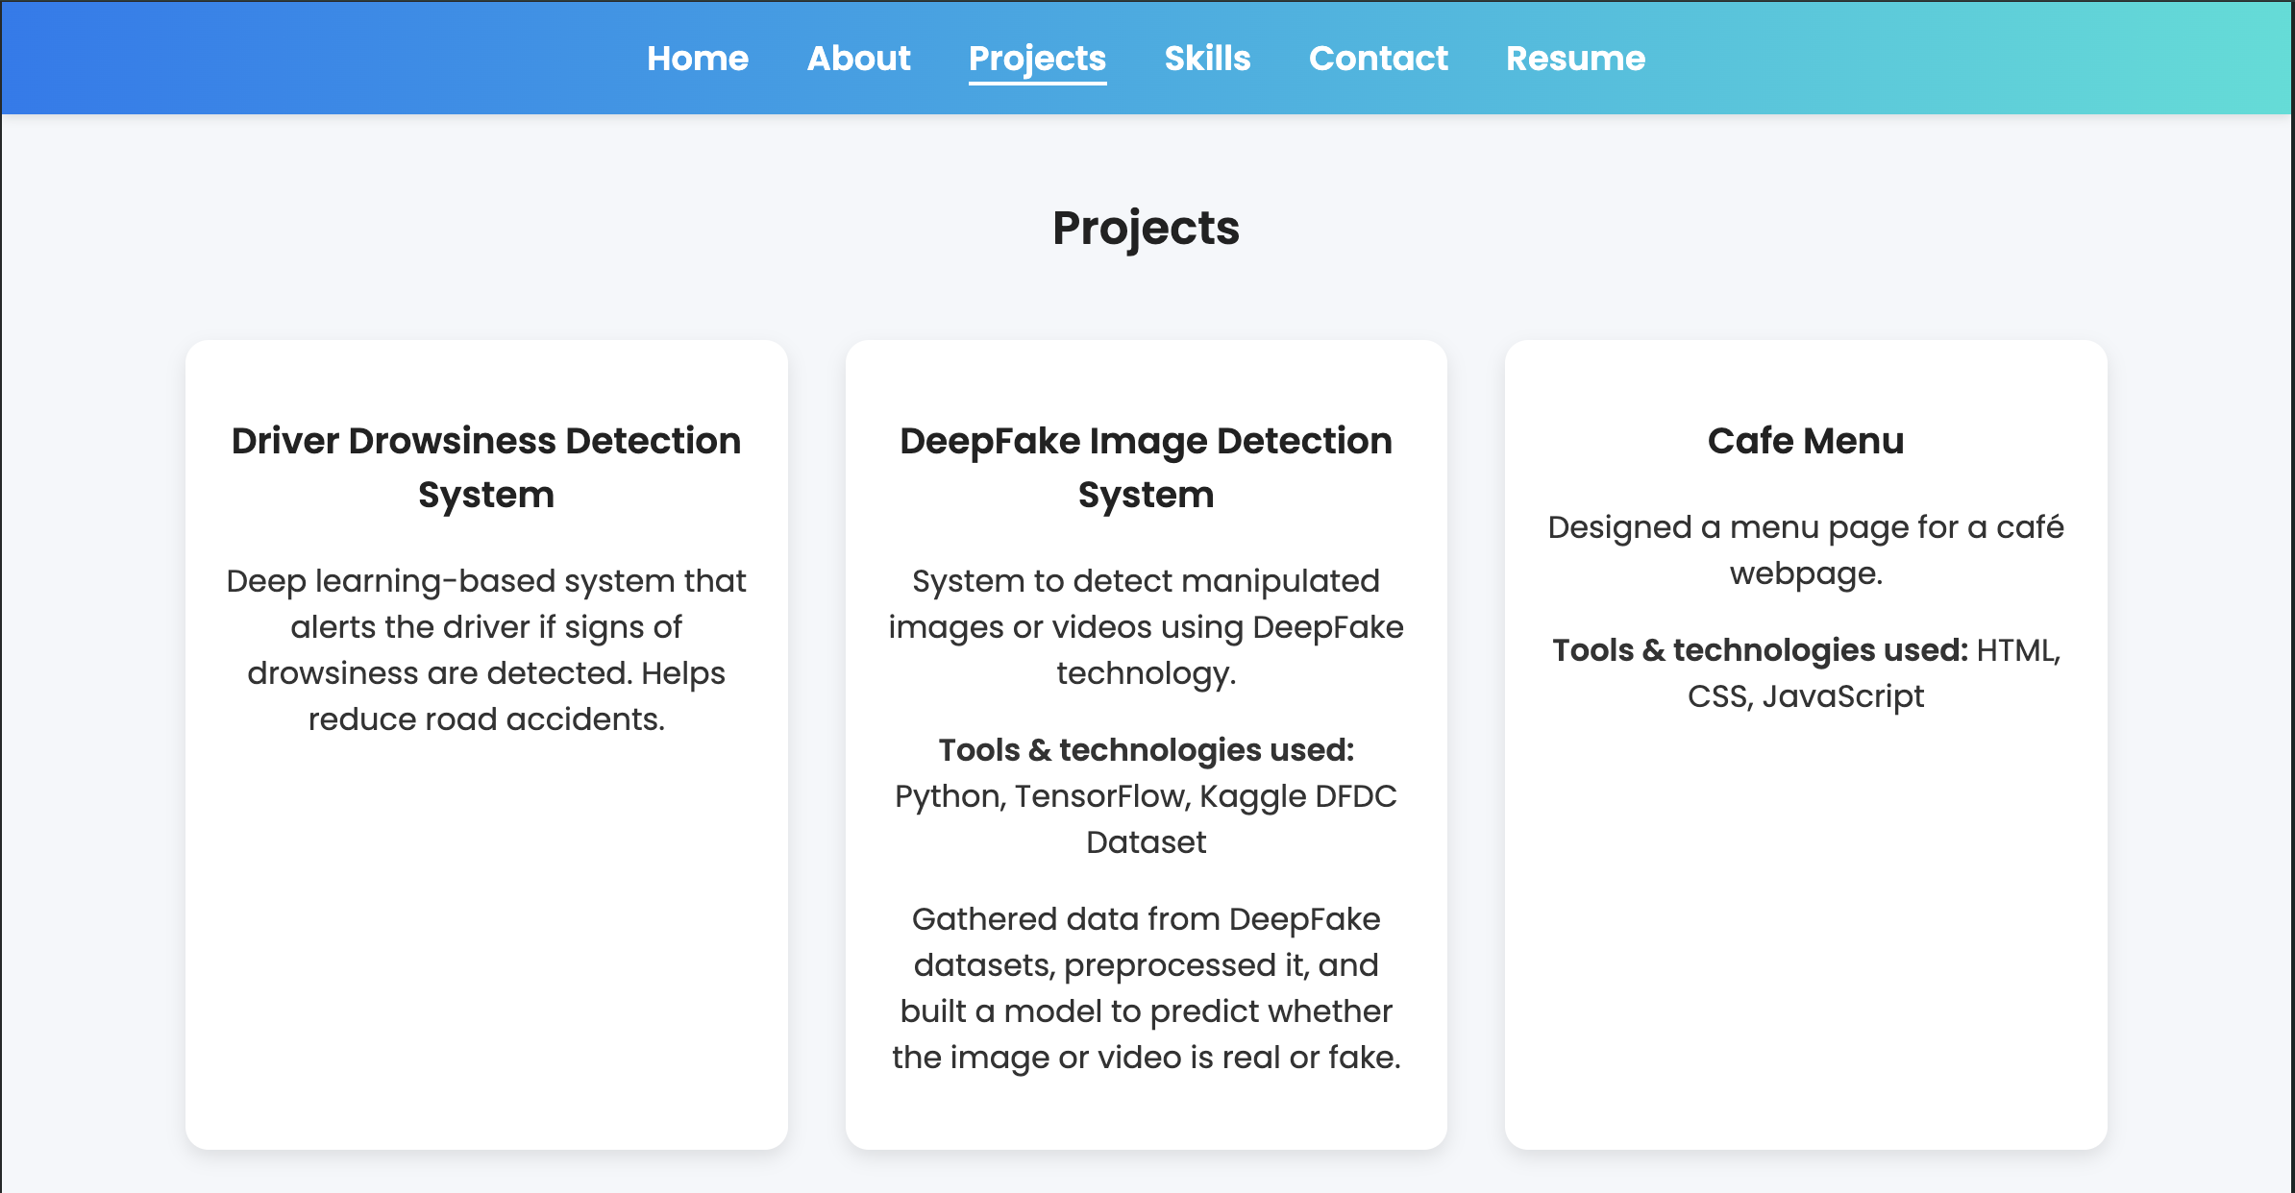
UI Preview
Home Page
Contact Page
About Page
Projects Page

Slide 8
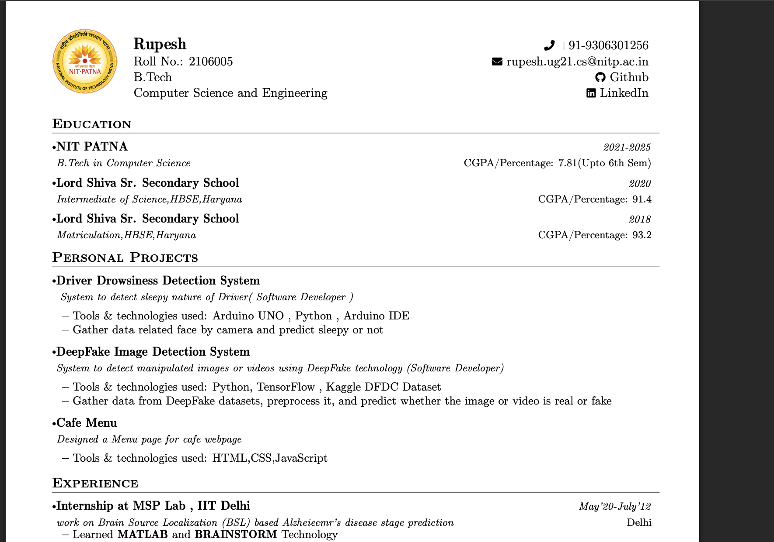
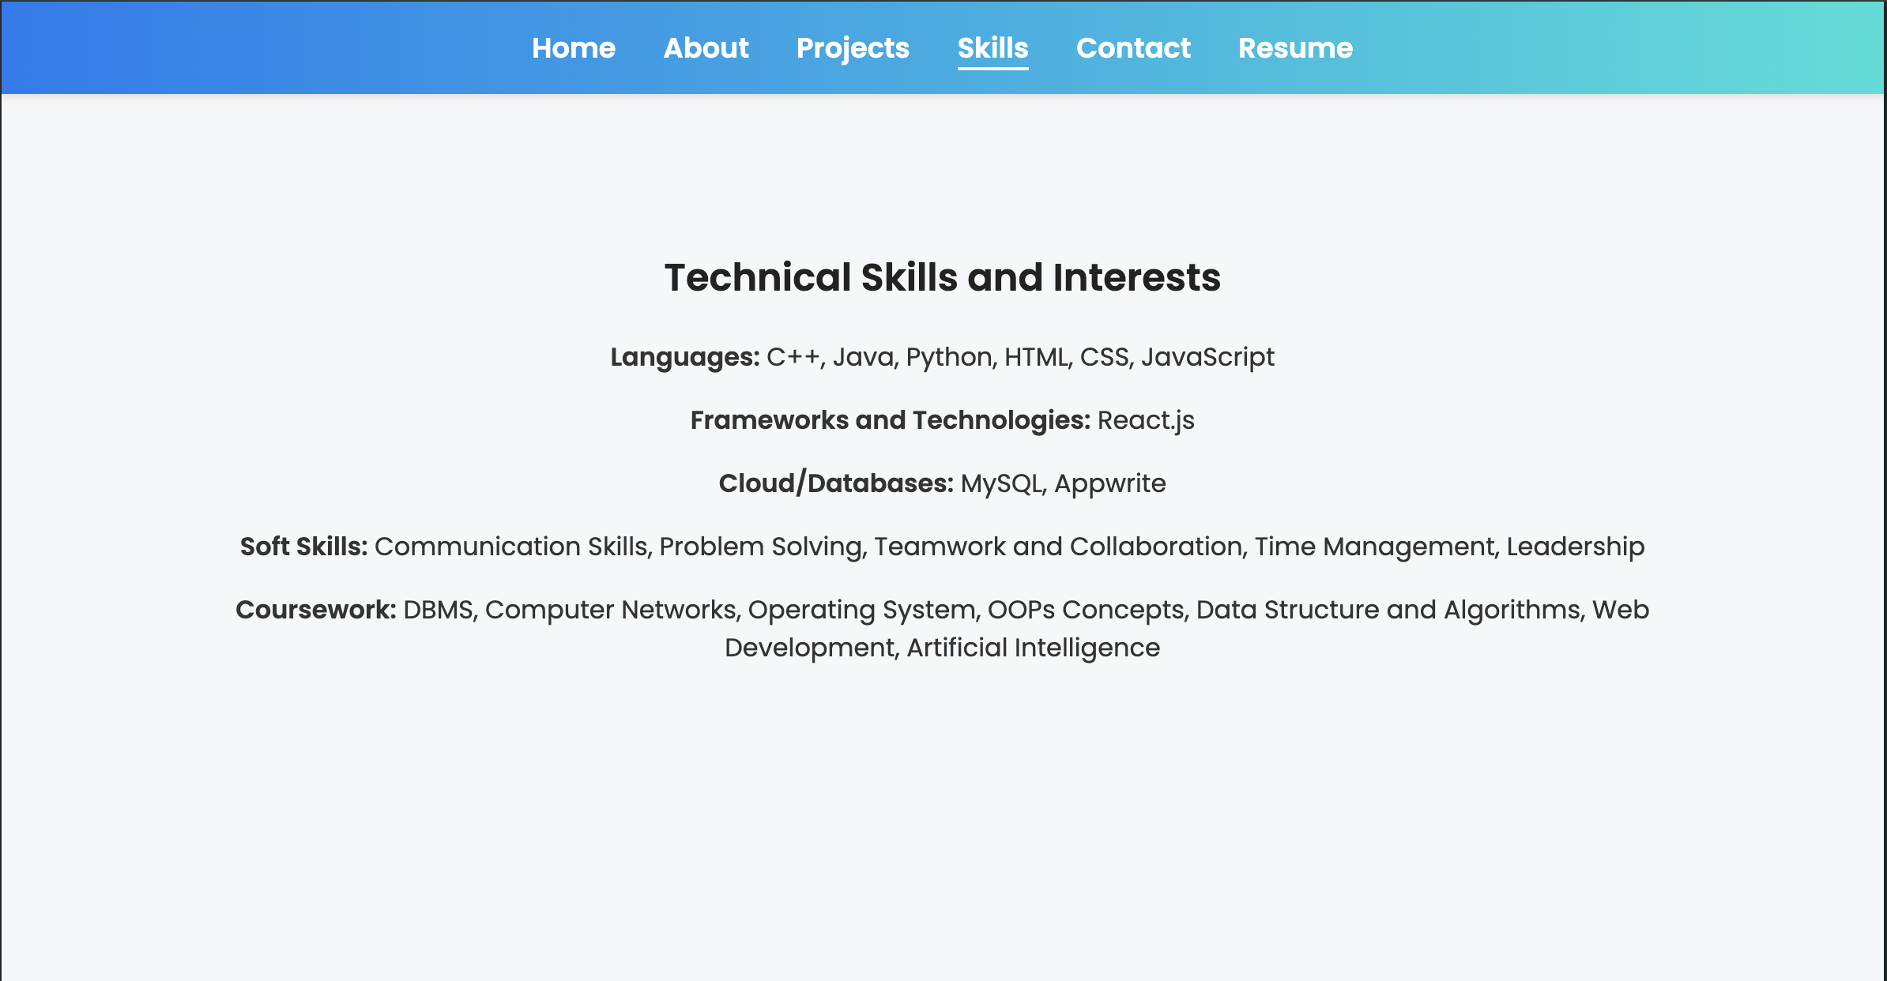
UI Preview
Skills Page
Resume displays on new window when click on resume page

